Slide 1

Southampton Analytica
How does personality effect reviews for businesses?
Chris Culley, Claudia Subia Pico, Fairouz AlDabbagh, Jak Hall, Sam Banks

Slide 2



Our Project
The aim of this project is to see whether personality type effects business reviews.
Personality type is classified by the Myers-Briggs type indicator (MBTI).
Business reviews were selected from the Yelp dataset from Kaggle.
Once the MBTI was applied to the Yelp dataset, we see how personality effects reviews.

Slide 3
The Steps Taken
Pre-Processing
Predictive Modelling
Apply Best Model to Yelp
Analysis of Yelp Reviews

Slide 4
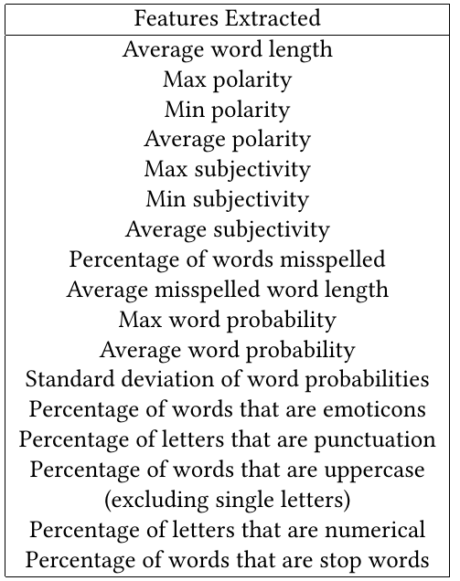
Pre-Processing
Reducing the bias of the dataset through re-sampling separate balanced datasets by target.
Combine reviews from the same person into a corpus and perform feature engineering.
Turn the corpus into a bag-of-words.
Scale the data for machine learning algorithms
Normalise the Yelp dataset using its own mean and standard deviation.

Slide 5
Machine Learning Model Results

Slide 6
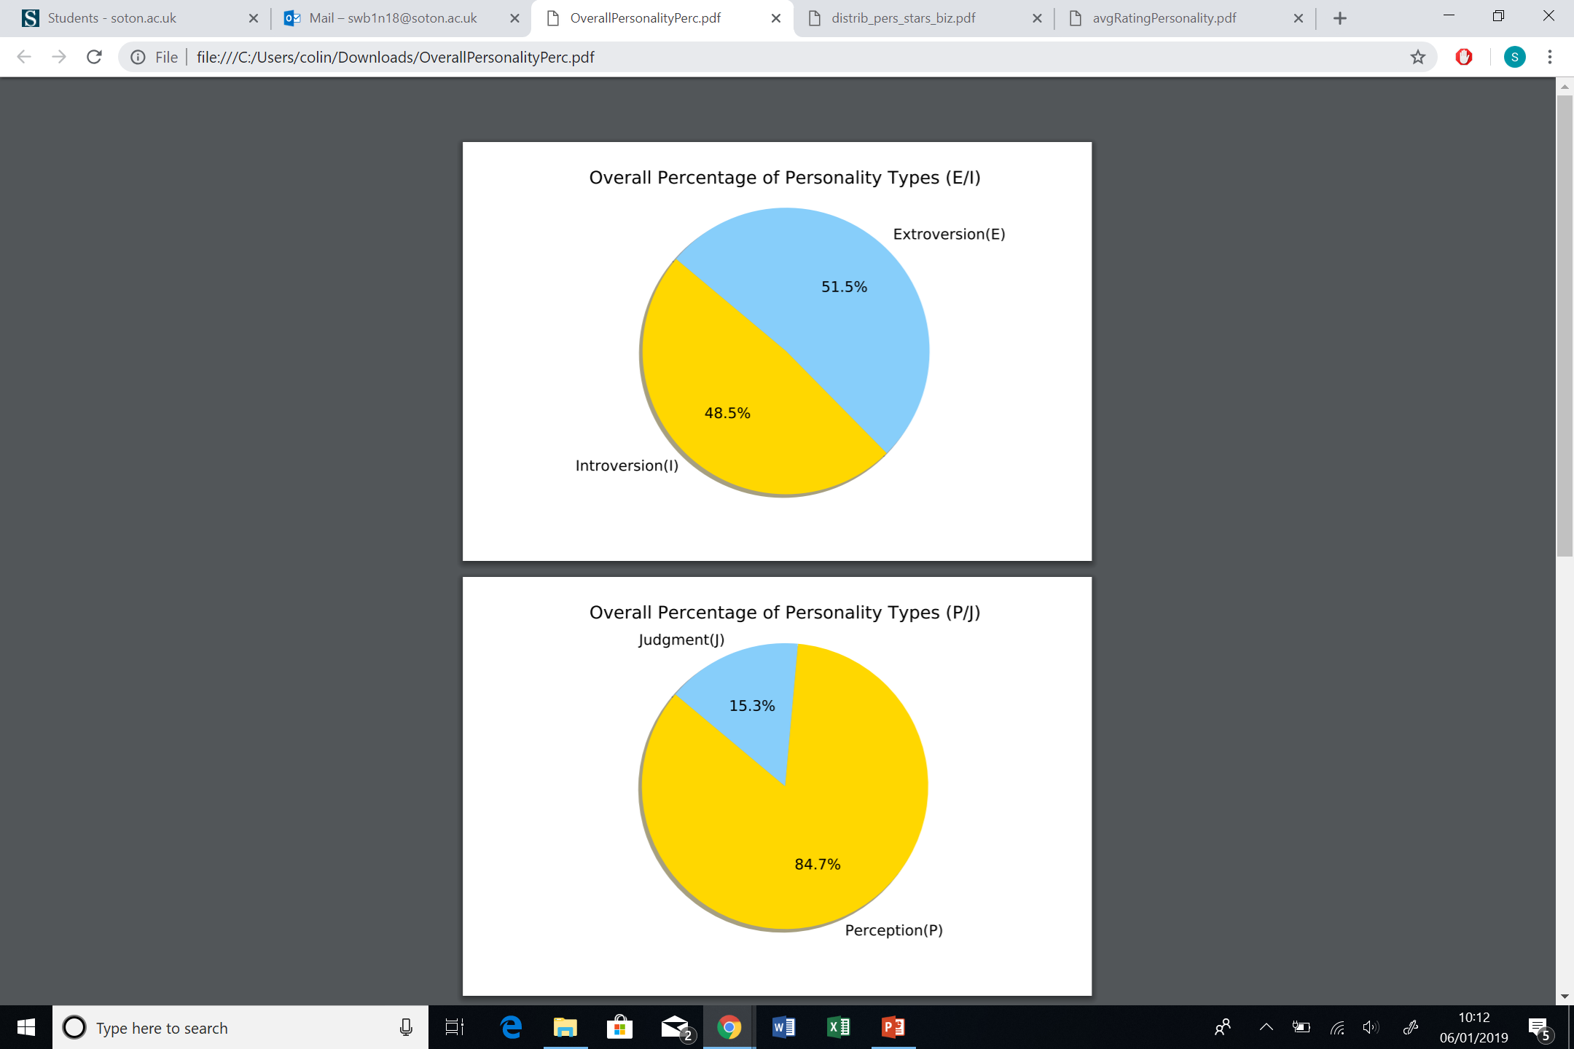
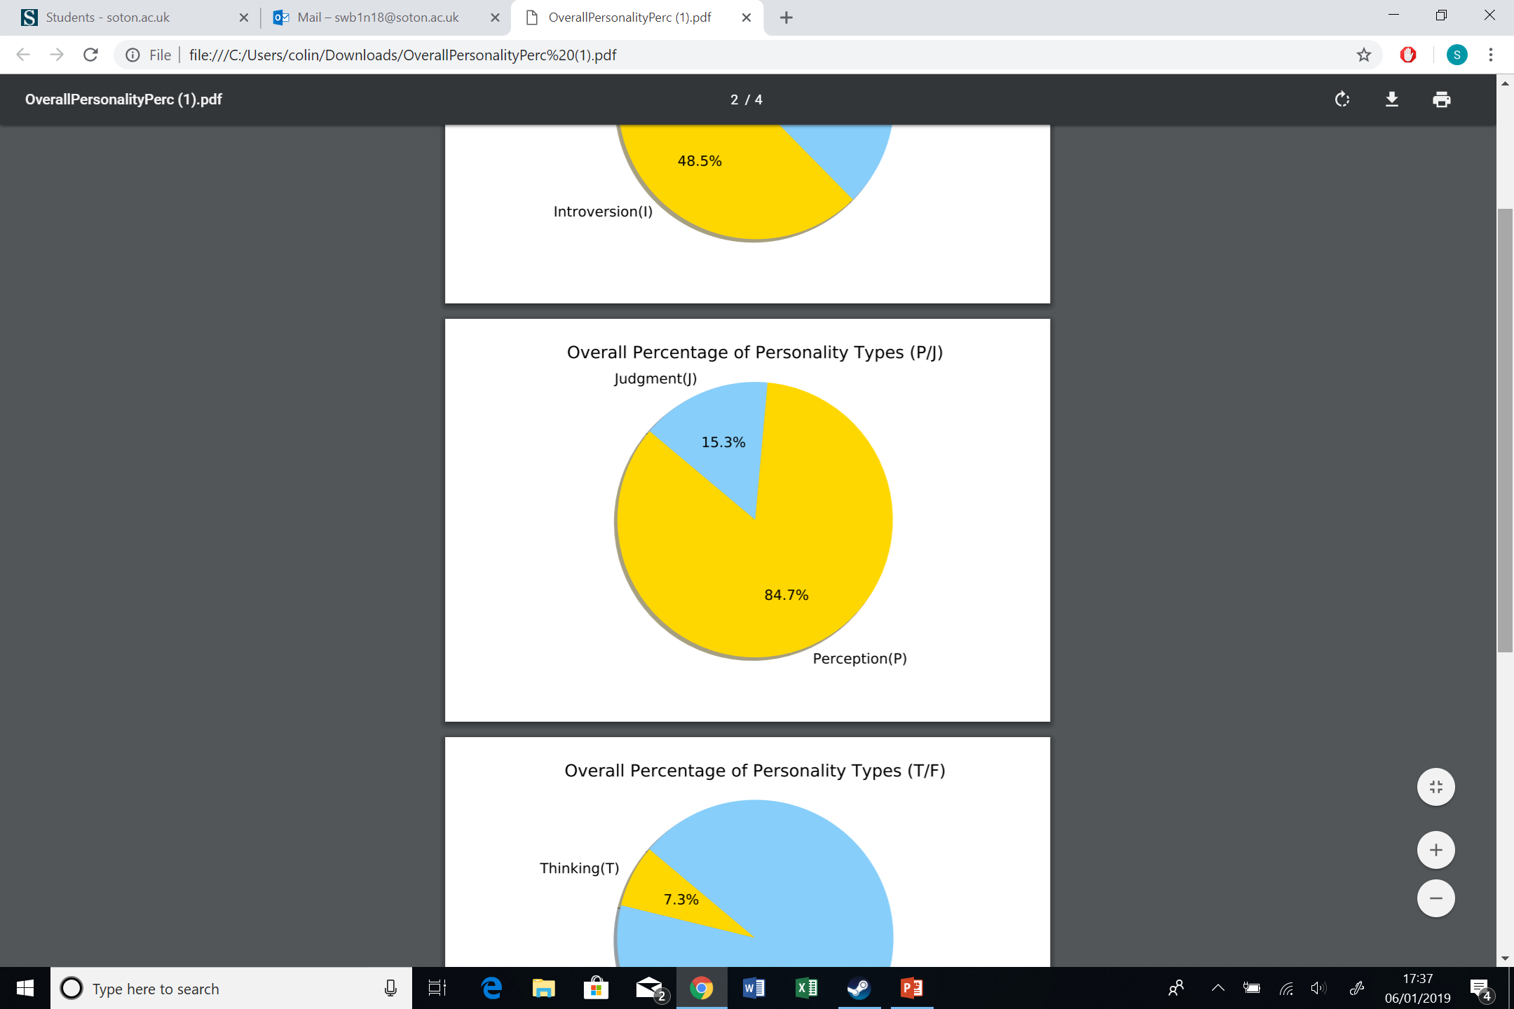
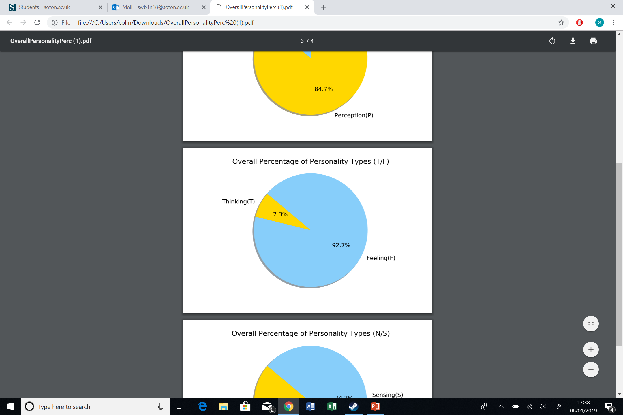
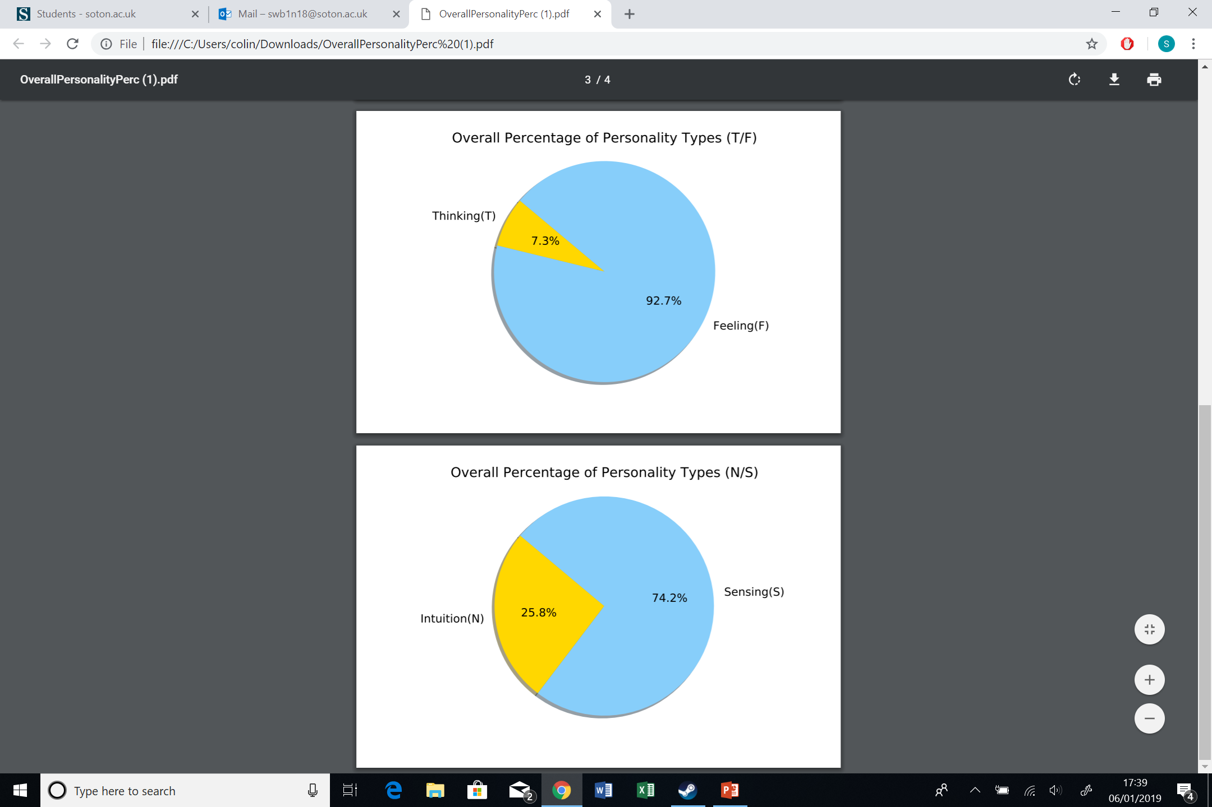
Analysis of the Yelp Dataset

Slide 7
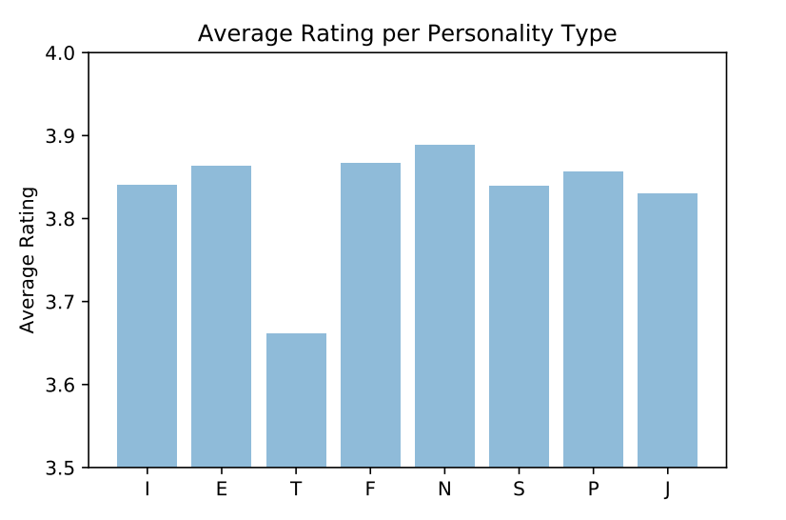
Analysis of the Yelp Dataset

Slide 8
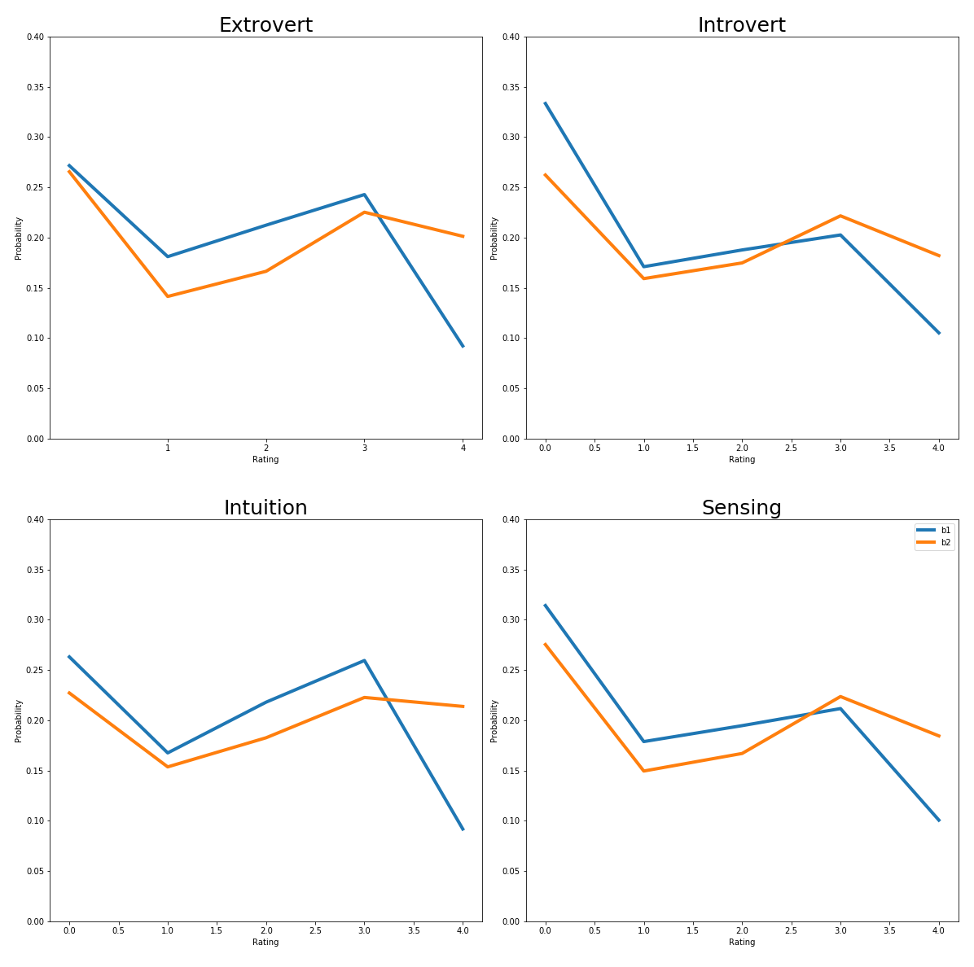
But how can this help a business?

Slide 9
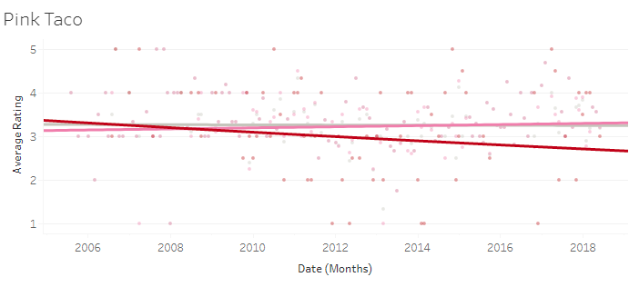
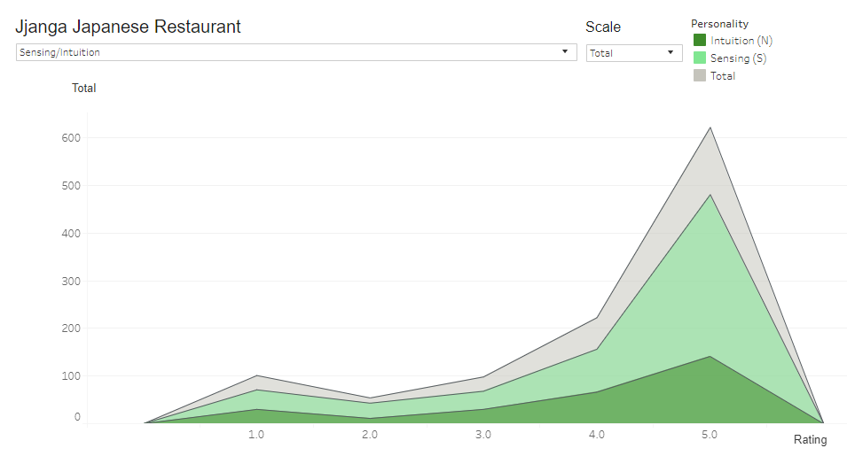
The Application
A tableau dashboard demonstrating our models applicability.
Allows businesses to compare the personality composition of local competitors.
Displays business details, features and location.
Provides a visualization for rating distribution and trend lines for 8 personality types. (ESTJ vs INFP)
Expandable to include more business types and locations.

Slide 10
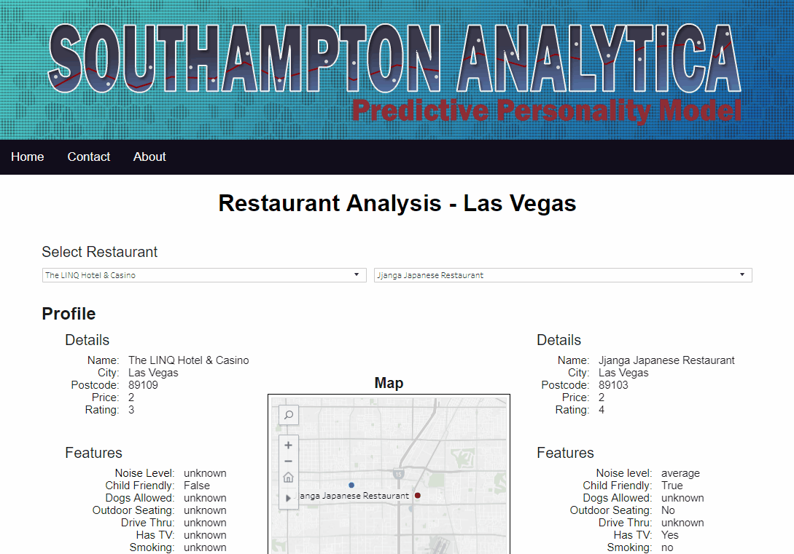

Slide 11
In Summary
The datasets used are the Yelp and MBTI datasets from Kaggle.
To use the datasets, the reviews were turned into a corpus and then into a bag of words and extensive feature engineering used to build predictive models using SVM’s Neural Networks, Logistical Regression and Random Forest algorithms.
The best predictive model was applied to the Yelp dataset for each of the four personality indicators.
The analysis of the yelp dataset yielded the average rating per personality type, overall percentage of personality type and personality distribution can then be utilised by businesses to understand their customer base better.
The application compares two different businesses and gives a schematic of the ratings distributed across the personality types

